Slide 1
Introduction to Snakemake and Nextflow
EBI Primer for Predocs 2021
Leah Rosen Predoc, Marioni Group
lrosen@ebi.ac.uk

Slide 2
What are Workflow Managers?
Automate computational pipelines
Run multiple scripts in succession
Calculate dependencies
Figure out which scripts need to be rerun
Scale to multiple inputs
Portable to different systems
Works with conda, docker, singularity *and EBI cluster*
The two common workflow managers: Snakemake and Nextflow
Snakemake is easier to learn, used by more bioinformaticians (and what I use)

Slide 3
Snakemake
Fantastic tutorials: https://snakemake.readthedocs.io/en/stable/tutorial/tutorial.html
Can learn basics by working through the tutorial in an afternoon
I still learn things about snakemake every day
Many EBI predocs use snakemake: If you have any questions ask the group!
Snakemake also has good introductory slides: Shameless theft

Slide 4
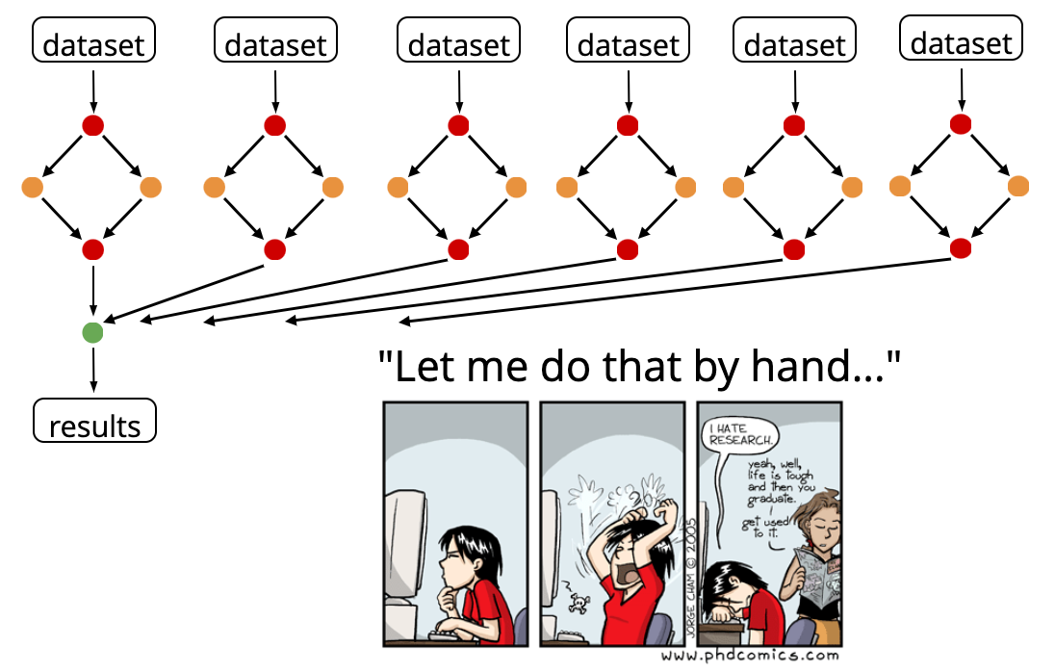
Why use a workflow manager?
Adapted from Johannes Köster

Slide 5
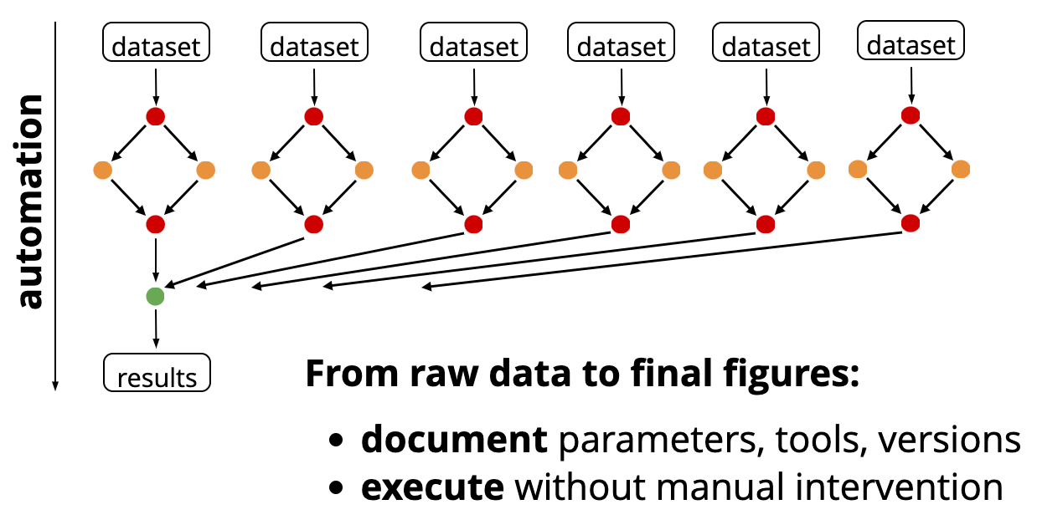
Why use a workflow manager?
Adapted from Johannes Köster

Slide 6
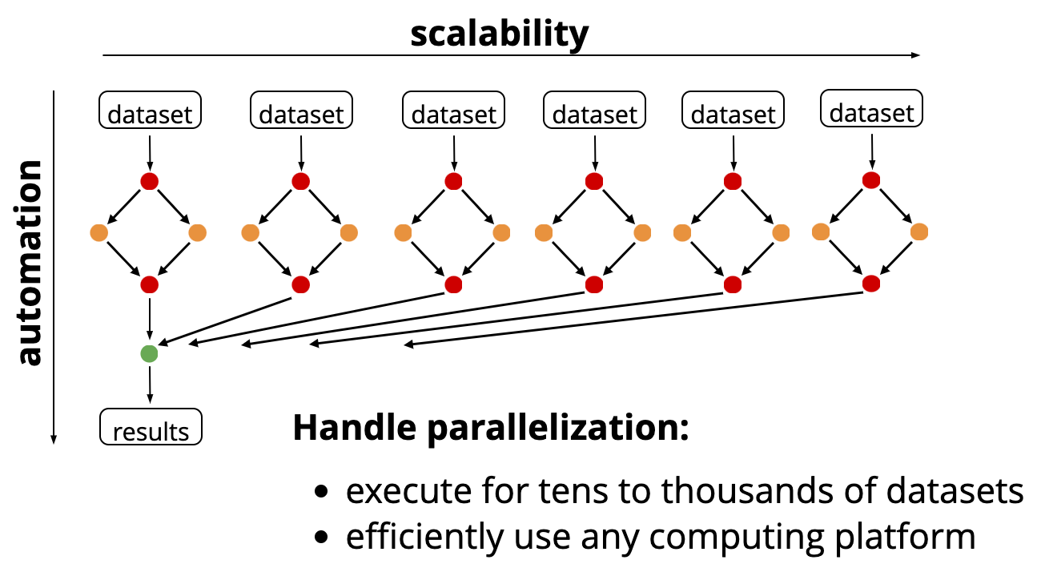
Why use a workflow manager?

Slide 7
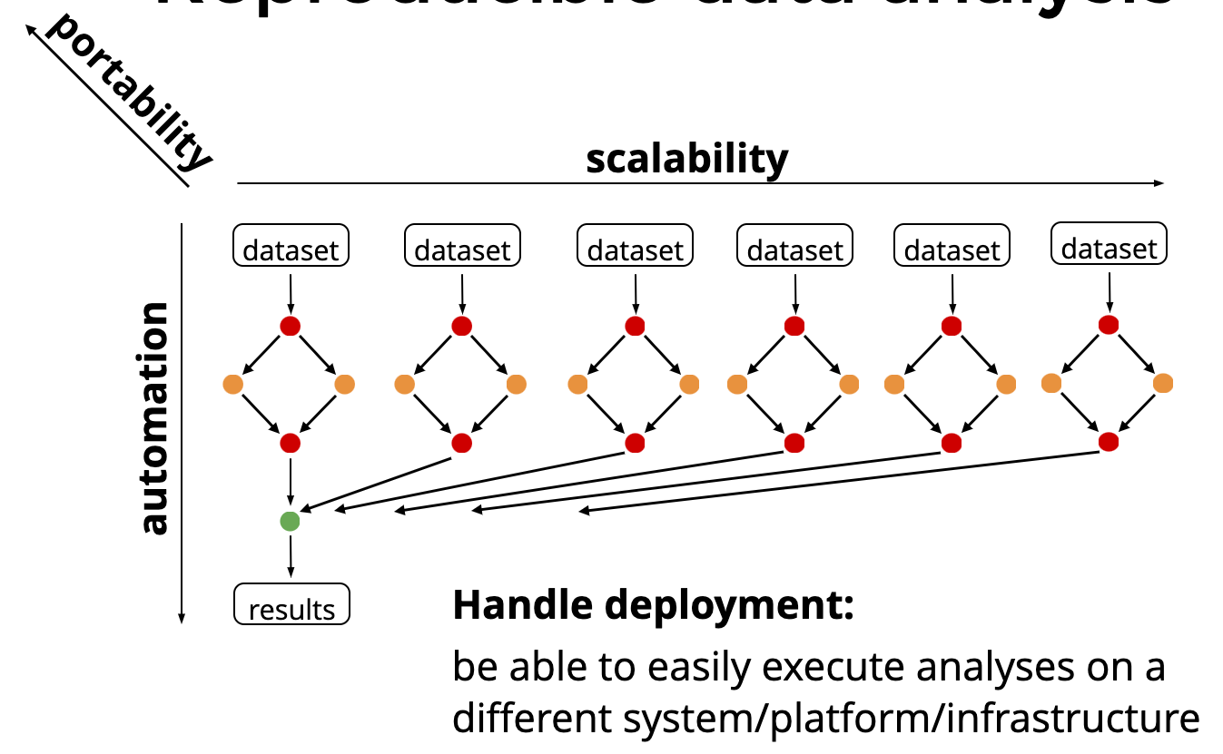
Why use a workflow manager?

Slide 8
How does snakemake work?
Make “Snakefile”
Run “snakemake” in the directory with the Snakefile
Starts with output, works backwards

Slide 9
How does snakemake work?
Make “Snakefile”
Run “snakemake” in the directory with the Snakefile
Starts with output, works backwards

Slide 10
How does snakemake work?
Make “Snakefile”
Run “snakemake” in the directory with the Snakefile
Starts with output, works backwards

Slide 11
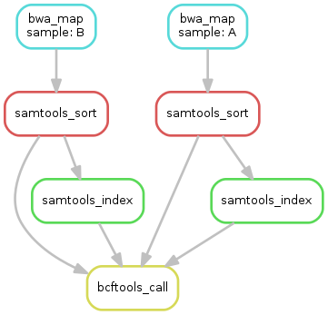
How does snakemake work?
Make “Snakefile”
Run “snakemake” in the directory with the Snakefile
Starts with output, works backwards

Slide 12
How does snakemake work?
Make “Snakefile”
Run “snakemake” in the directory with the Snakefile
Starts with output, works backwards

Slide 13
How does snakemake work?
Make “Snakefile”
Run “snakemake” in the directory with the Snakefile
Starts with output, works backwards
Not output by any other rule

Slide 14
How does snakemake work?
Make “Snakefile”
Run “snakemake” in the directory with the Snakefile
Starts with output, works backwards

Slide 15
How does snakemake work?
Make “Snakefile”
Run “snakemake” in the directory with the Snakefile
Starts with output, works backwards

Slide 16
How does snakemake work?
Make “Snakefile”
Run “snakemake” in the directory with the Snakefile
Starts with output, works backwards

Slide 17
How does snakemake work?
Sets options
Make “Snakefile”
Run “snakemake” in the directory with the Snakefile
Starts with output, works backwards
Only takes specified input
Specifies ”wildcards”

Slide 18
Some more snakemake options
Submit snakemake by just writing “snakemake” in command line, if Snakefile in that directory
Run with “-n” for dry run; Run with “-k” flag to make it continue even if one job fails
Run ”snakemake --dag | dot -Tsvg > dag.svg” to generate graph visualisation
Set options in a config file
Specify rule dependencies using conda
Virtualise with singularity (and Docker)
Have snakemake submit individual jobs to cluster or Provide snakemake with multiple cores and it’ll run each rule on a separate core
Vary conda environments by adding “conda run –n [conda_env]” to shell

Slide 19
Learn snakemake!
Snakemake’s own tutorial: https://snakemake.readthedocs.io/en/stable/tutorial/tutorial.html
Work through basic → advanced
Brice Letcher and Michael Hall made a Snakemake code formatter! https://github.com/snakemake/snakefmt
An advanced example of Snakemake: https://github.com/theislab/scib
Get in touch with me if you have any questions! Happy to share example code

Slide 20
Nextflow vs Snakemake
Snakemake | Nextflow
Easier to learn Uses pythonic syntax | Harder to learn Takes a while, so only worth it if larger workflow Uses Groovy programming language: Easier to learn if you have a Java background Some people find Nextflow structure more intuitive
Starts with required output files and builds DAG backwards | Starts with input files and builds a DAG upwards
 | More flexible
Has a dry-run option (an ability to check which files will be affected by the run without actually triggering pipeline) | Need testing dataset to test pipeline
More commonly used by bioinformaticians

